Slide 1

IMDB Movie Rating Prediction -Presented by- Karthikeya T 116A3023 Shwetha M 116A3033 Princy N 116A3037 Under Guidance of Prof. Seema Redekar
R Mini Project Presentation

Slide 2
CONTENTS
Abstract
Introduction
Proposed System
Results and Discussions
Summary
Conclusion
References

Slide 3
ABSTRACT
The project is based on the Prediction of movie ratings before it is released in the theaters. There are thousands of movies that are produced each year, but the greatness of the movie without relying on critics is not achieved. Infact, there is no universal way to claim the goodness of movies. Many people rely on critics to gauge the quality of a film, while others use their instincts. But it takes the time to obtain a reasonable amount of critic’s review after a movie is released. And human instinct sometimes is unreliable. Thus, the main aim of the project is to find the movie’s actual release using optimal parameters with highest accuracies.

Slide 4
INTRODUCTION
Movies is the most convenient way to entertain peoples. A movie revenue depends on various components such as cast acting in a movie, budget for the making of the movie, film critics review, rating for the movie, release year of the movie, etc.
For movie audience, the prevalent immodest advertisement and promotion makes it hard to choose a movie worth watching. Therefore, both sides demand a reliable prediction of what people will think about a particular movie before it is actually released or even during its planning phase.
Sometimes, it is hard to find the ratings of a movie before it is released in the Theatres. Many people rely on critics to gauge the quality of a film, while others use their instincts.
There are thousands of movies which are produced each year, but there is no better way to tell the greatness of movie without relying on critics or our own instincts. So, the problem is how one can say the greatness of a movie before it is released in cinema.
So, in this project we used machine learning algorithms like KNN, CART, Random forest to predict the ratings before movie’s actual release using optimal parameters with highest accuracies.

Slide 5
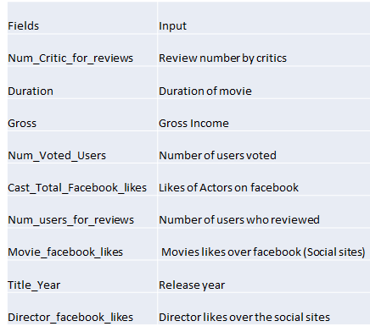
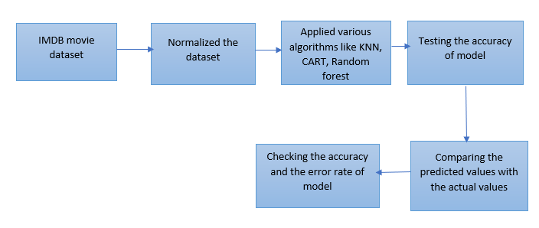
PROPOSED SYSTEM
Dataset used: IMDB 5000 Movie dataset
In this dataset, we are predicting the movie ratings before movies actual release using the optimal parameters with highest accuracies with the help of ML algorithms like KNN, CART, Random Forest
We used confusion matrix of R to calculate the performance of the classification model used and correlation matrices to understand the relationship among the variables that are mentioned in Fig.1.
Fig 1. Dataset attributes Fig 2. Workflow

Slide 6
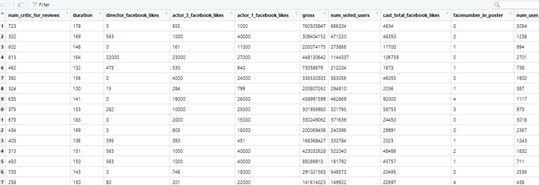
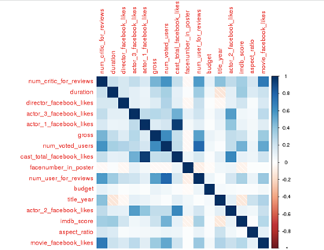
RESULTS AND DISCUSSION
The data is imported from the kaggle website.
Fig 3. Dataset table
Cleaning the data:
From the chunk of data, only the required data is added into the data frame.
Data Normalization and Visualisation:
We have considered the variables for the predicting model from
the common factors from different websites and we also have
created a correlation matrix between
response and independent variables.
Fig 4. Visual correlation

Slide 7
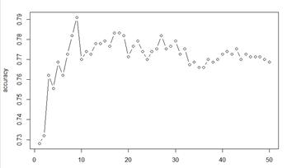
RESULTS AND DISCUSSION(continued..)
4. Model Selection and Prediction:
KNN (K-Nearest Neighbors) Alogrithm:
K-Nearest Neighbor is an example of instance-based learning, in which the training data set is stored, so that a classification for a new unclassified record may be found simply by comparing it to the most similar records in the training set.
We divided our dataset in 20% - Test and 80% - Train data and we applied the KNN algorithm over the training dataset and tested the model on our test Dataset.
We started with different values of K for prediction starting with K=5 and increasing thereafter. With K=5 we got an accuracy of 76.47% and misclassification rate of 23.52%
To increase the prediction accuracy rate we tried different values and found highest accuracy for K=16 as 78.71% and misclassification rate of 21.28%, which is shown in above graph.
Fig 5. KNN prediction accuracy rate

Slide 8
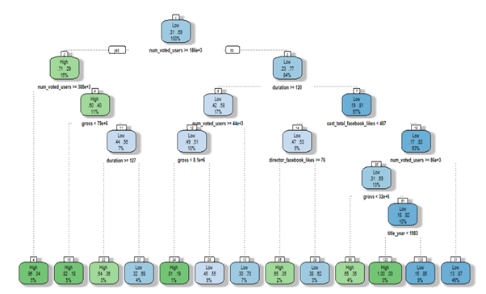
2. CART (Classification and Regression Tree) Algorithm:
The CART algorithm grows the tree by conducting for each decision node, an exhaustive search of all available variables and all possible splitting values, selecting the optimal split according to the following criteria.
We divided our dataset in 20% - Test and 80% - Train data and we applied the CART algorithm over the training dataset and tested the model on our test Dataset.
For Implementing CART in RStudio we are using RPART function.
We found the accuracy to be 77.77%.and error rate of 22.22%.
Below is the decision tree after applying the model on our training dataset.
Fig 6.Decision tree

Slide 9
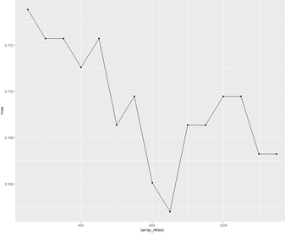
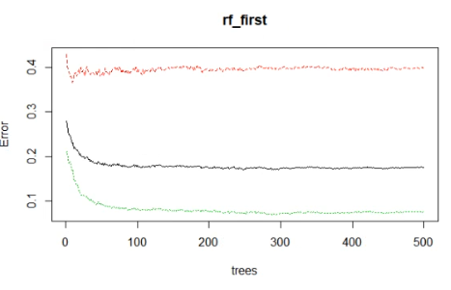
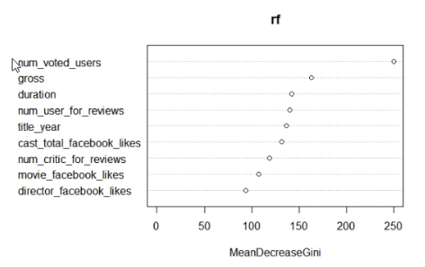
3. Random Forest Algorithm:
Random decision forests correct for decision trees' habit of overfitting to their training set. For Implementing Random Forest in RStudio we are using randomForest function.
After testing the model on our test dataset, we compared it with target variable and got accuracy of 82.52% and error rate of 17.47%.
Correlation between the predicted values and actual values is around 56.08%
After Changing the entry parameter to its optimal value in Random Forest
function it gained an accuracy of 82.64% and error rate of 17.35%.
Fig 6 : Tuning the n-tree parameter.
Fig 7 : without the n-tree parameter
Fig 8: r plot accuracy rate

Slide 10
SUMMARY
Through KNN,we tried to predict the accuracy for different values and found the highest accuracy rate for K=16 as 78.71%.
Next we used is CART(Classification and Regression Tree)algorithm using RPART function,we found the accuracy to be 77.77%.and error rate of 22.22%.
Random forest algorithm on our dataset and found the prediction accuracy is 82.64% which is the highest and best accuracy compared to the above.
KNN
CART
Random Forest

Slide 11
CONCLUSION
Finally we conclude by deducing that Random Forest can predict the highest accuracy on this dataset on the optimal variables considered by highest correlation values.
Thus, we can now predict the rating and the greatness of a movies before its released in cinema without relying on critics review or on own human instincts.
We can use this predictive model on any new dataset having the same variables for optimal solution.
For future scope we can predict the movie ratings even deeper based on other factors like the history of production house having it as a categorical factor.

Slide 12
References
[1] Mestyán, Márton, Taha Yasseri, and János Kertész. "Early prediction of movie box office success based on Wikipedia activity big data." PloS one 8, no. 8 (2013).
[2] Geng, Xin, and Peng Hou. "Pre-release prediction of crowd opinion on movies by label distribution learning." In Twenty-Fourth International Joint Conference on Artificial Intelligence. 2015.
[3] Shugan, Steven, and Joffre Swait. "Enabling movie design and cumulative box office predictions using historical data and consumer intent-to-view." University of Florida, working paper (2000).
[4] Yoo, Steven, Robert Kanter, and David Cummings. "Predicting Movie Revenue from IMDb Data." Stanford University (2011).
[5] Reddy, Ajay Siva Santosh, Pratik Kasat, and Abhiyash Jain. "Box-office opening prediction of movies based on hype analysis through data mining." International Journal of Computer Applications 56, no. 1 (2012): 1-5.
[6 ]Zhang, Wenbin, and Steven Skiena. "Improving movie gross prediction through news analysis." In 2009 IEEE/WIC/ACM International Joint Conference on Web Intelligence and Intelligent Agent Technology, vol. 1, pp. 301-304. IEEE, 2009.
[7] http://statweb.stanford.edu/~jtaylo/courses/stats202/ensemble.html
[8] https://www.youtube.com/watch?v=XLNsl1Da5MA&t=752s

Slide 13
THANK YOU

